Slide 1
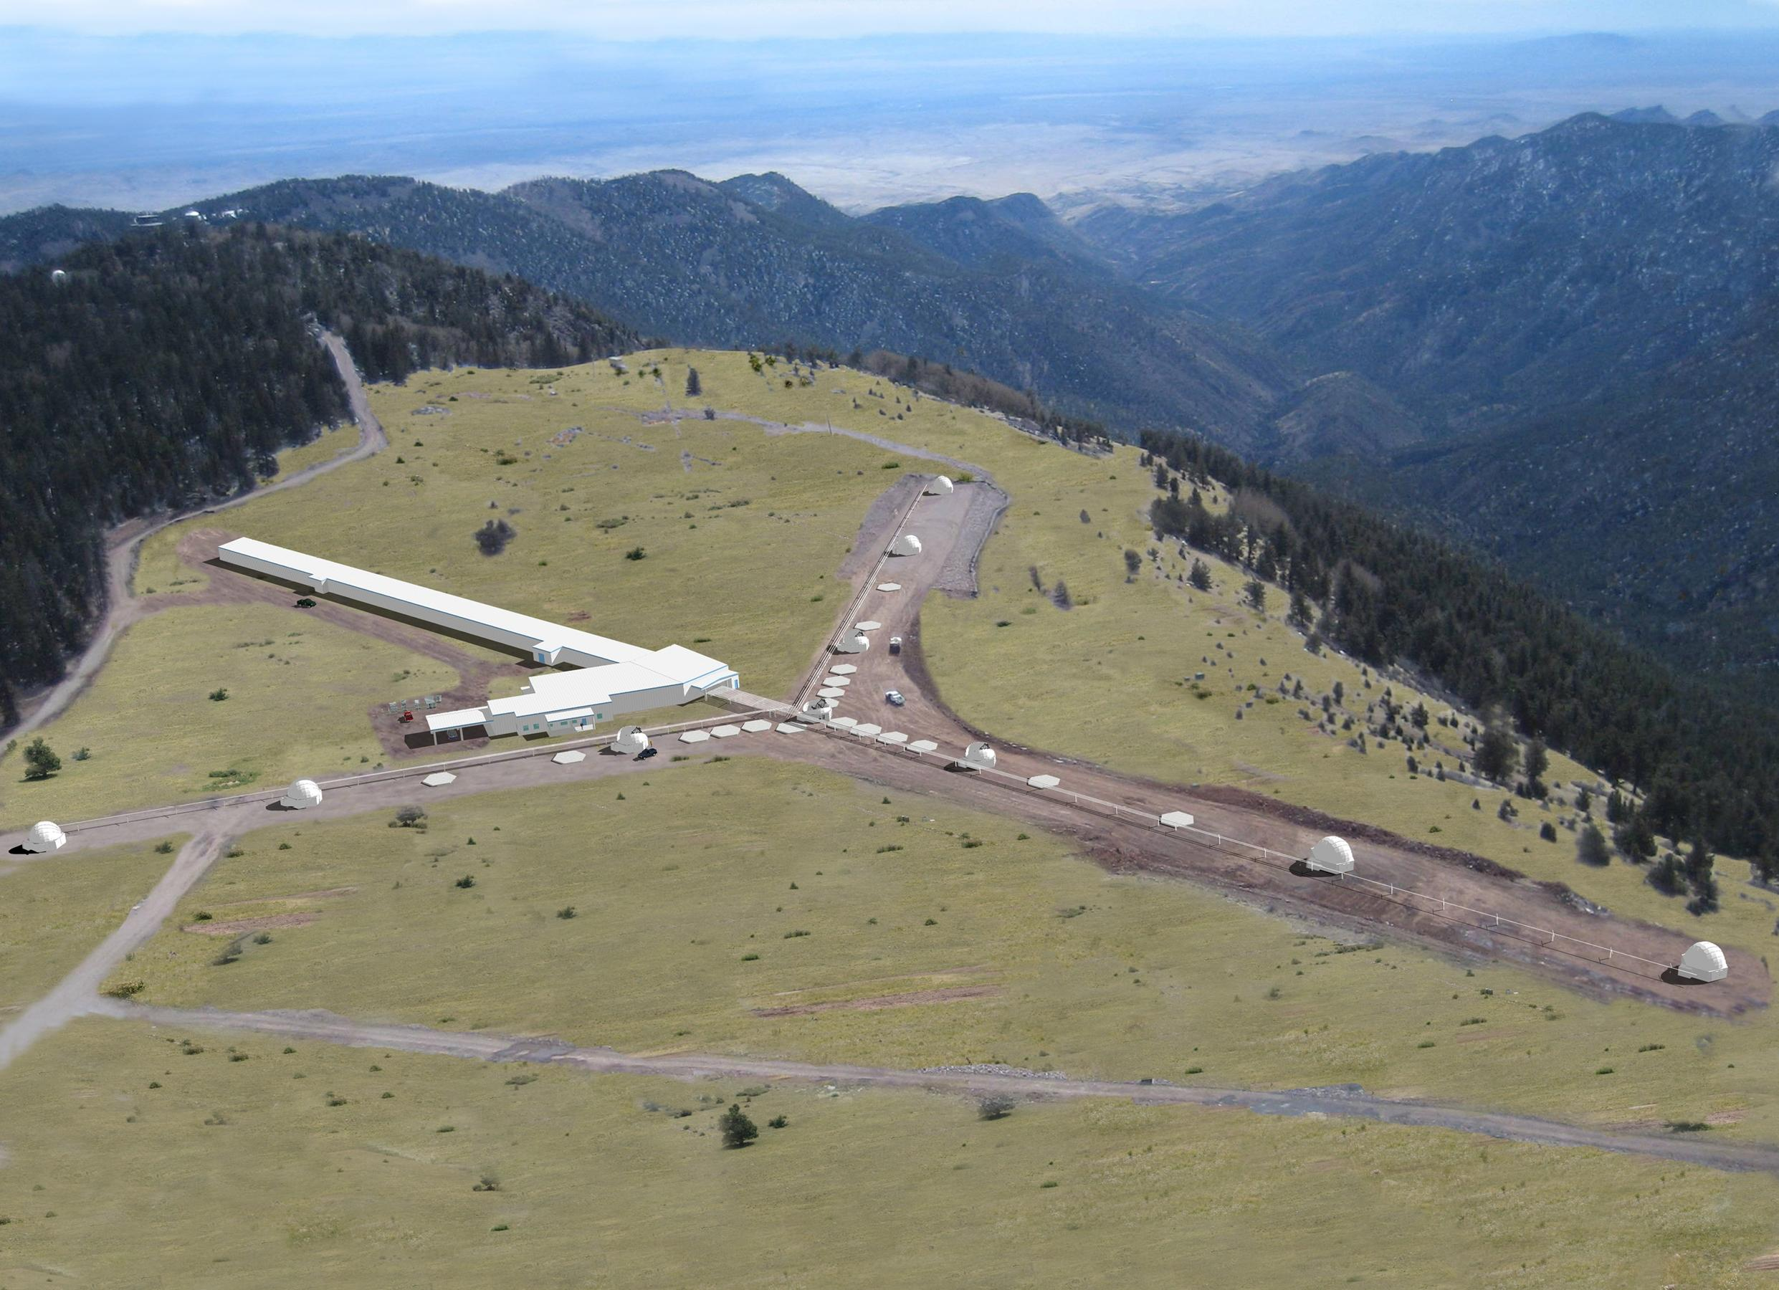



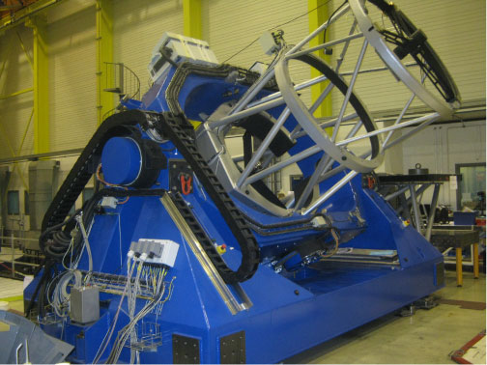
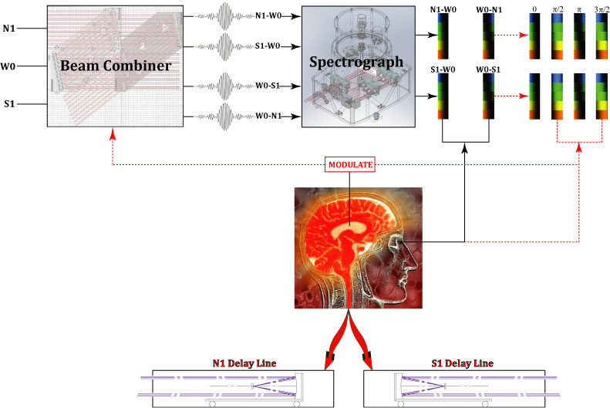
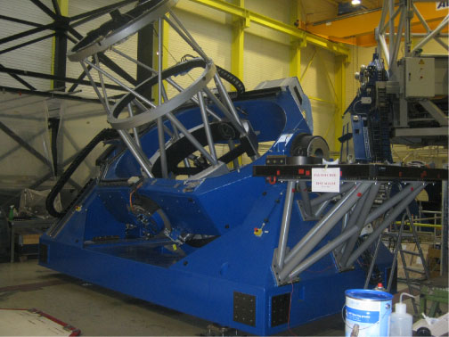
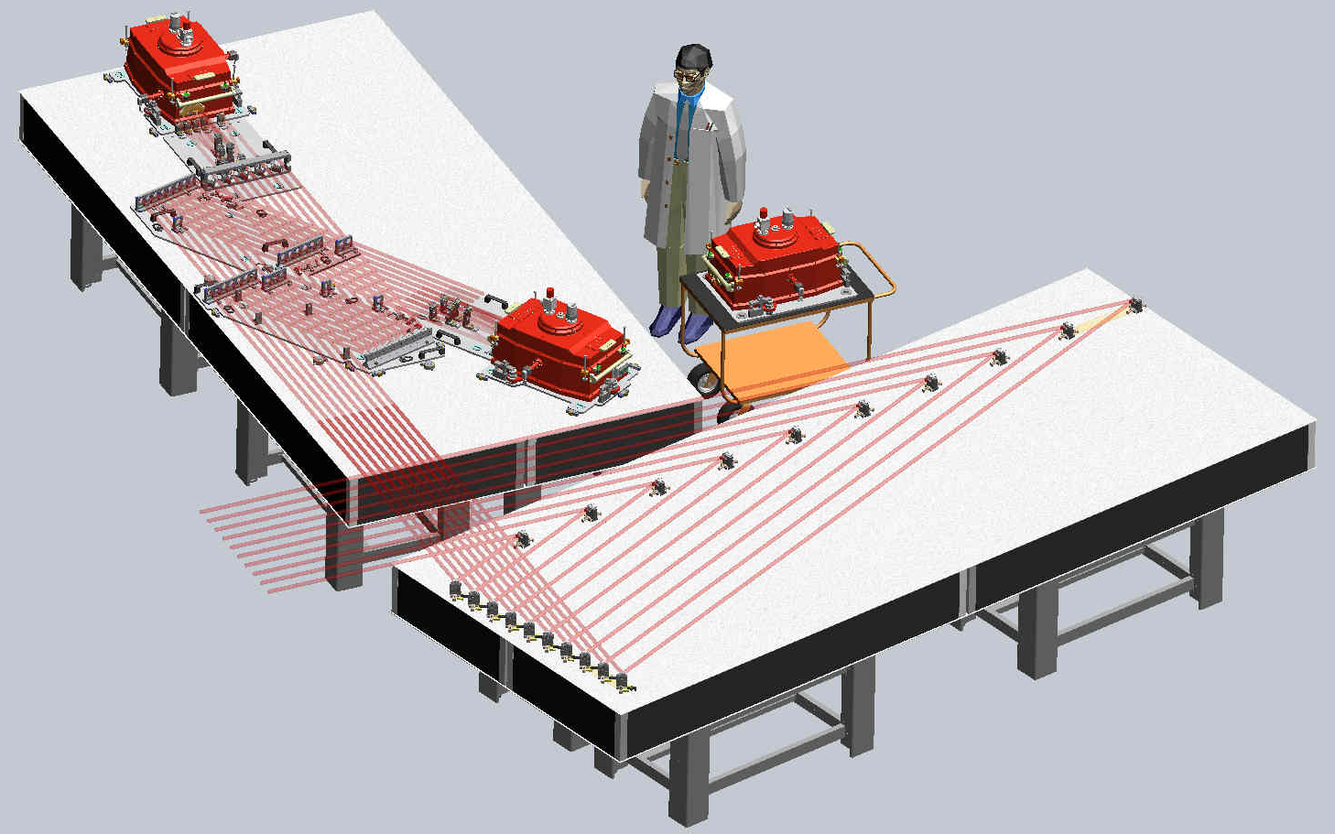
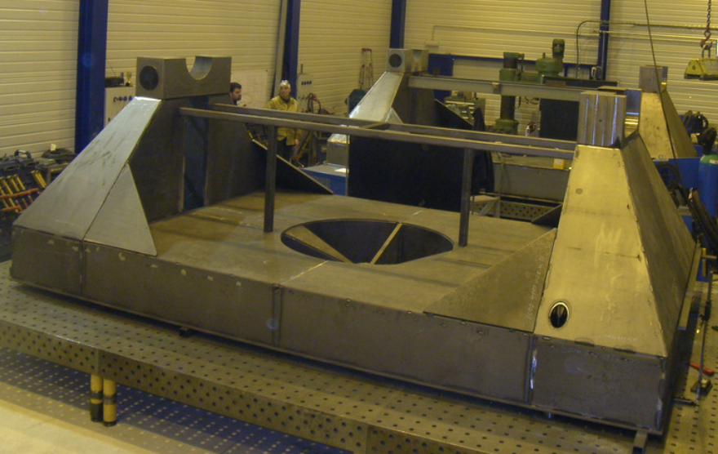
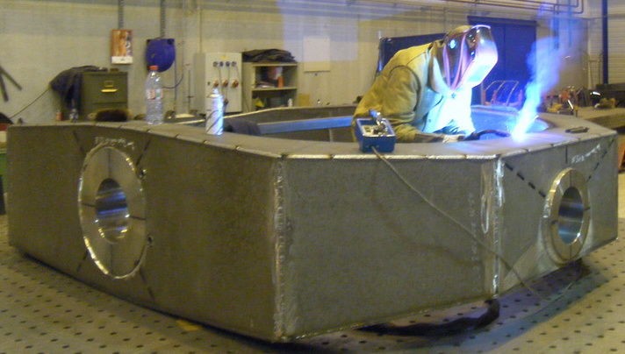
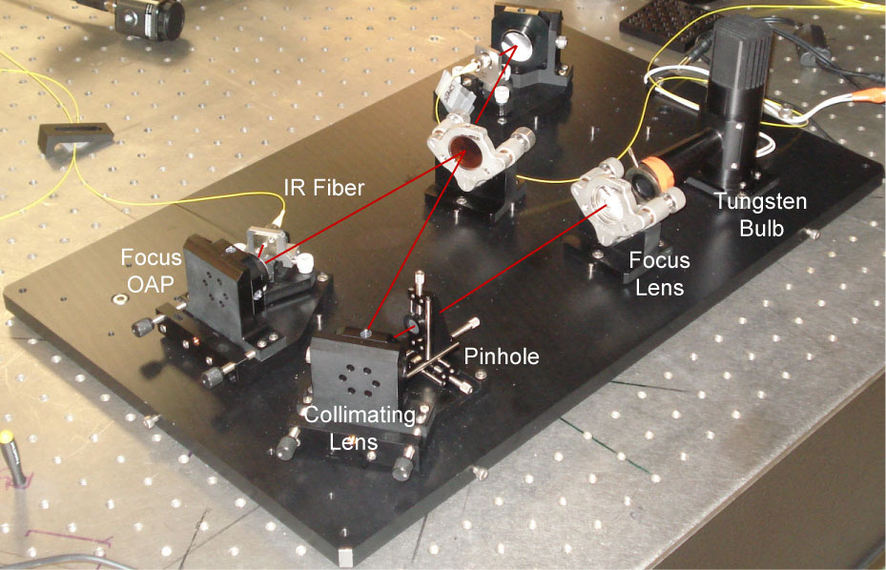
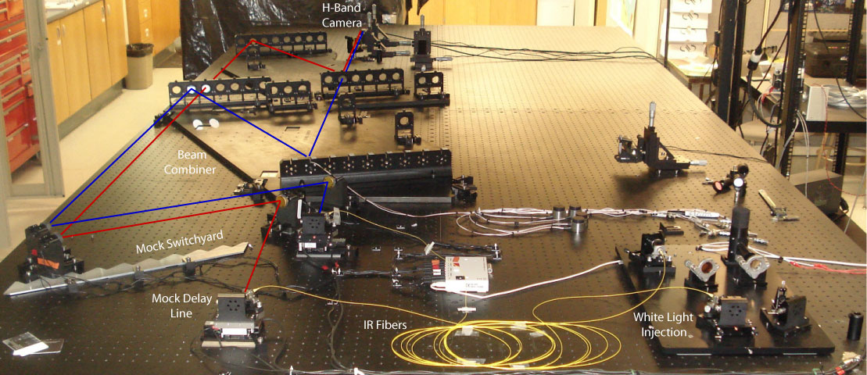
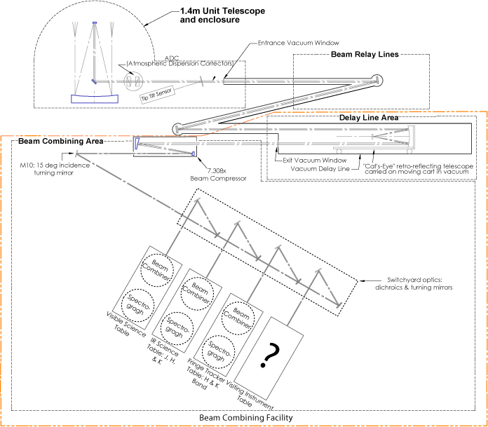
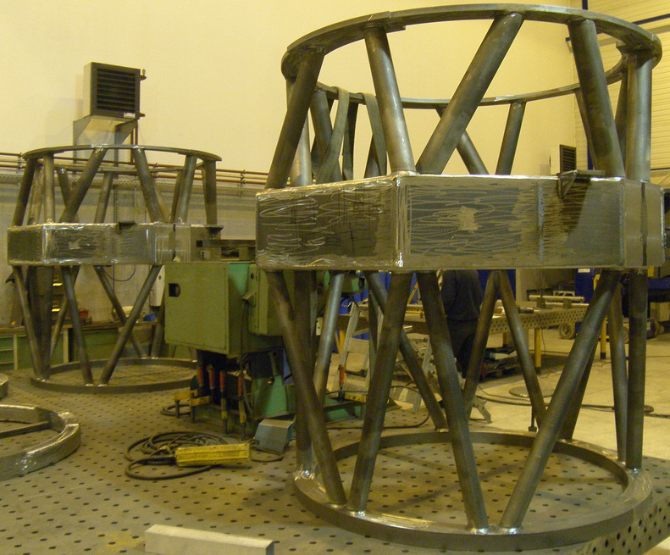
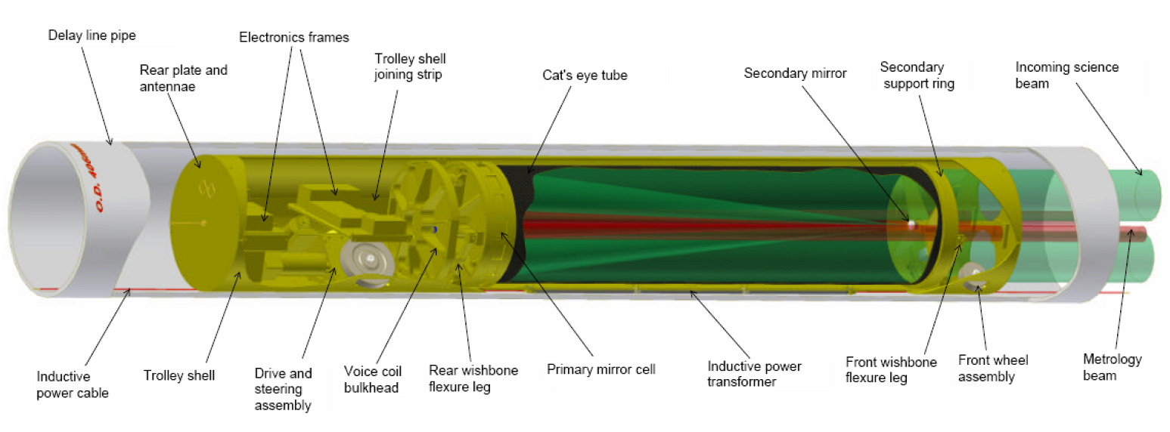
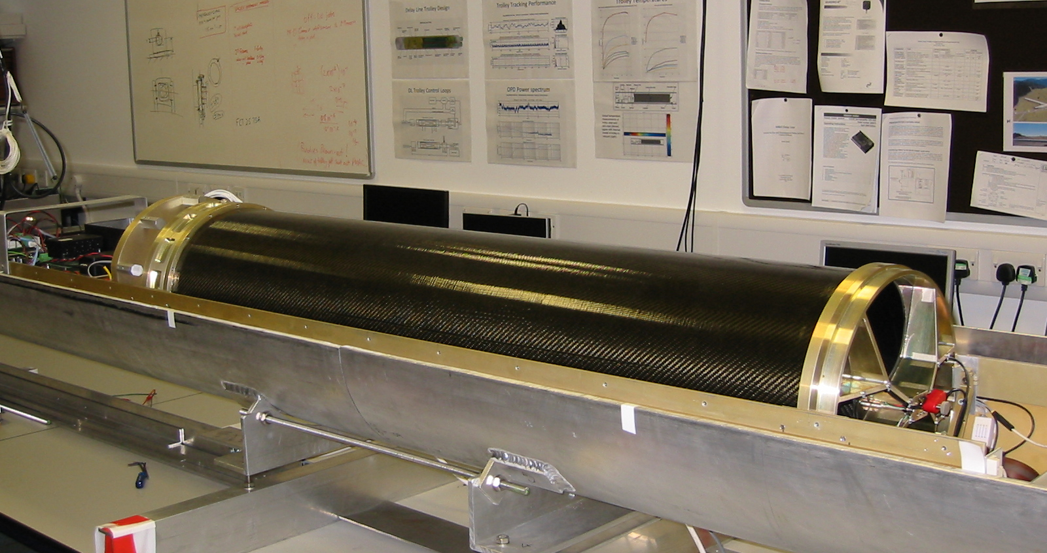






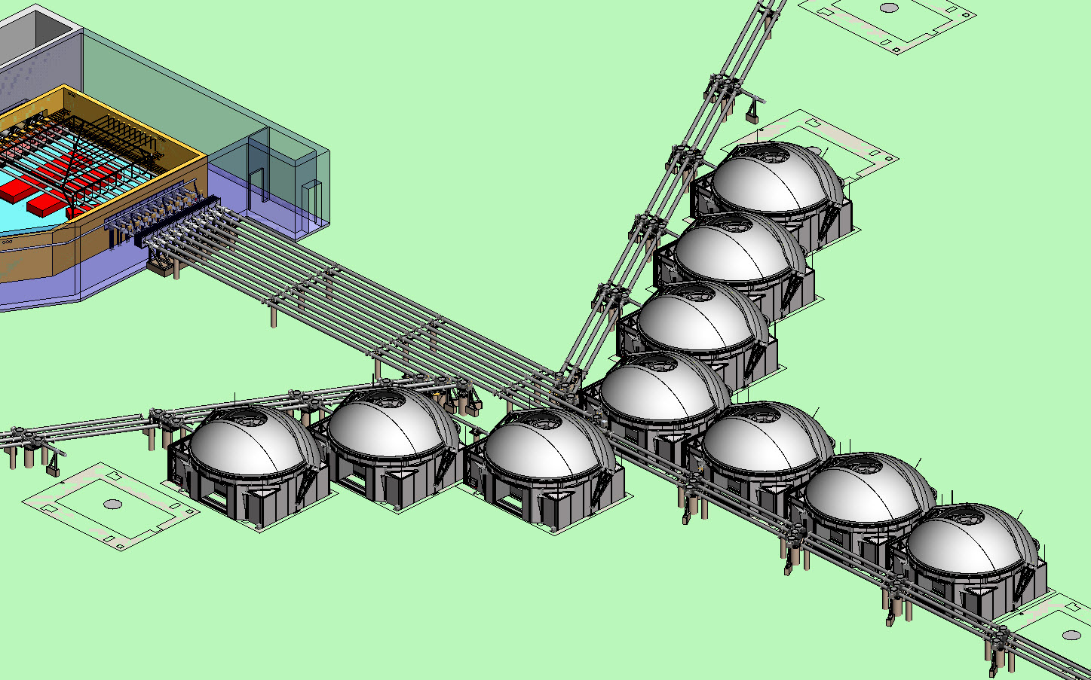
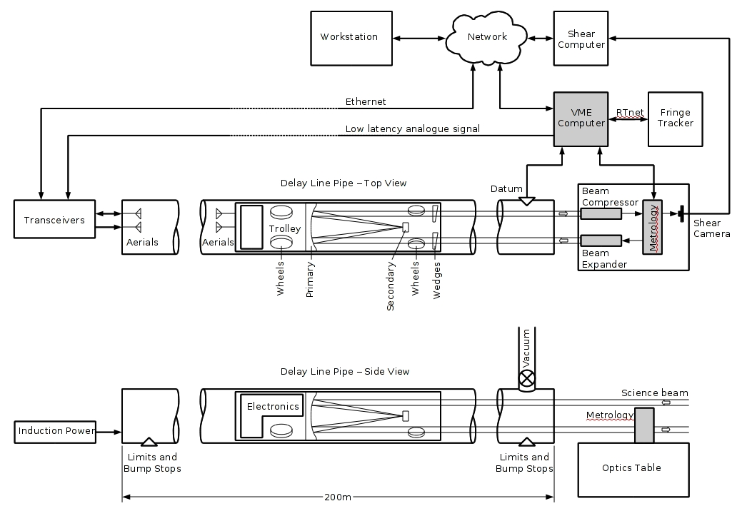
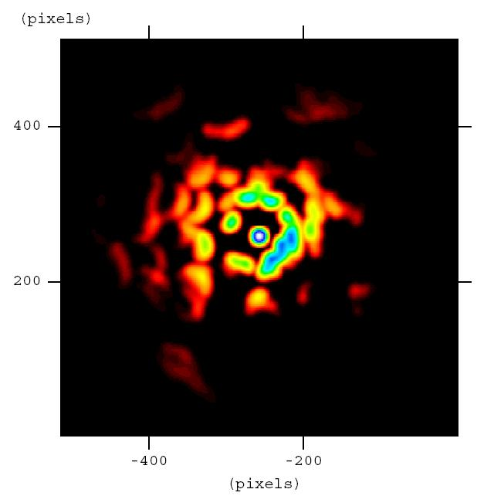
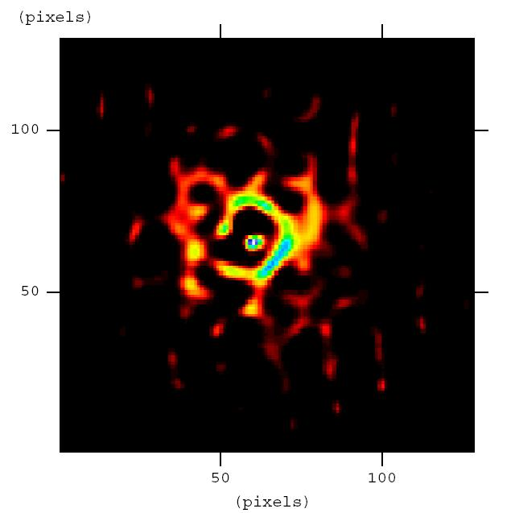
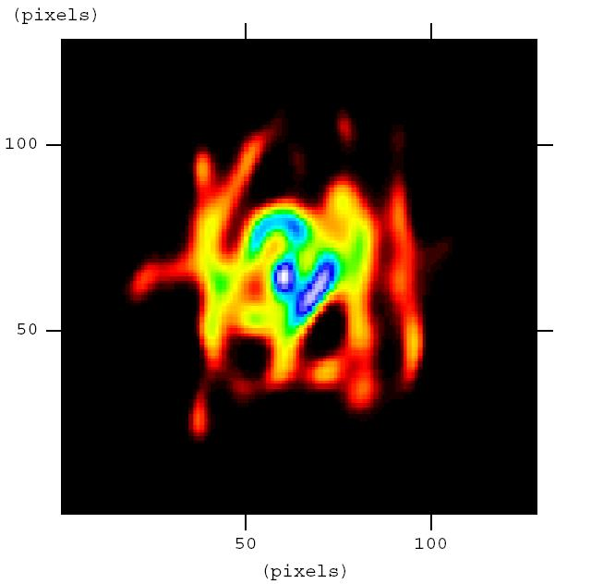
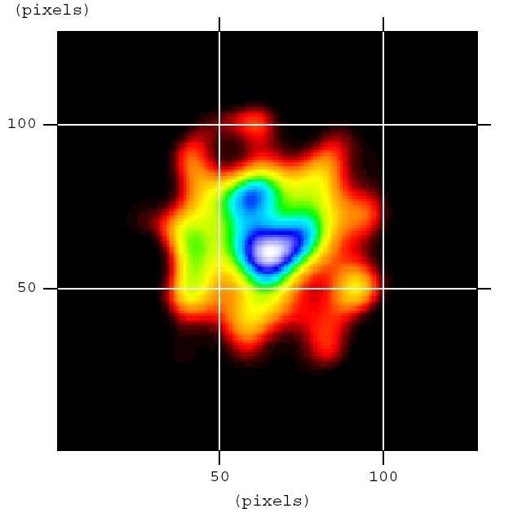
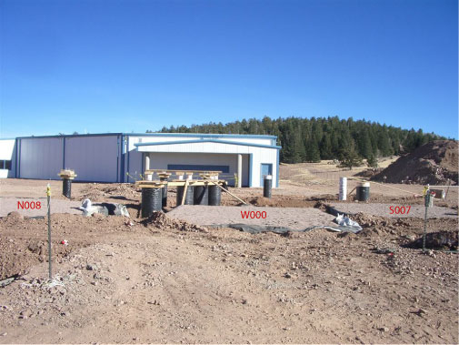
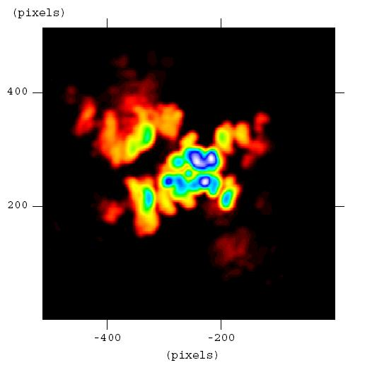
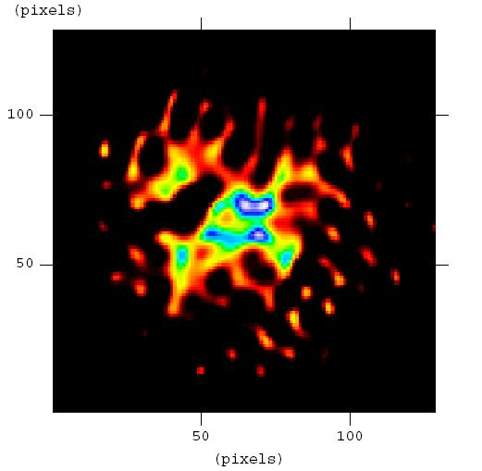
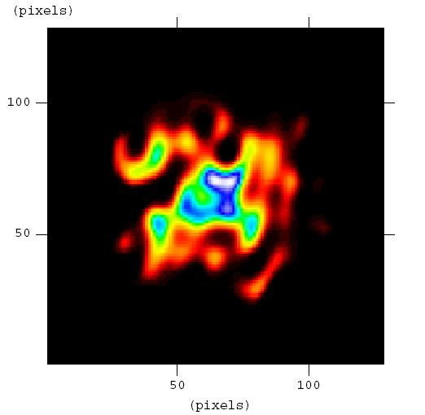
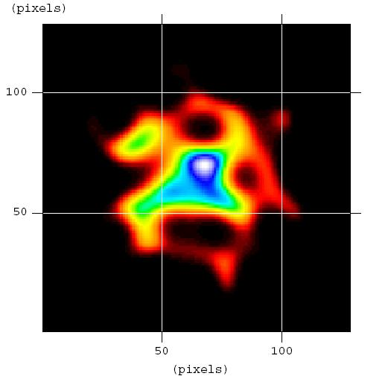

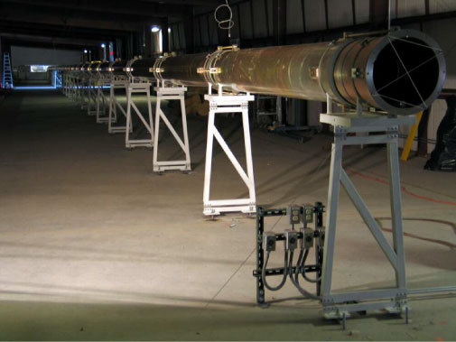
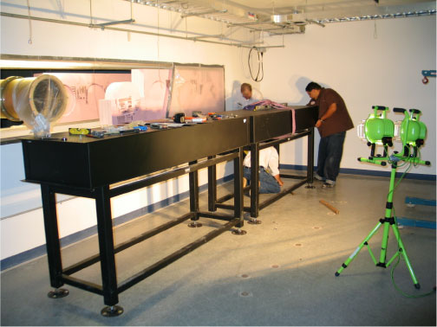
The Magdalena Ridge Interferometer: Telescope Delivery to Laboratory Fringe Measurements & Science Simulations
ªC. Jurgenson, ªF. Santoro, ªA. Olivares, ^{b}J. Young, ªR. Selina, ^{b}D. Busher, ^{b}C. Haniff, ªM. Creech-Eakman, ªT. McCracken, ªK. Nyland, ªI. Payne, ªA. Shtromberg
ª Magdalena Ridge Observatory, 101 East Road, Socorro, NM 87801 ,USA; ^{b} Cavendish Laboratory, J. J. Thomson Avenue, Cambridge CB3 0HE, U.K.
ABSTRACT
UNIT TELESCOPES
FRINGE TRACKER
This report focuses on recent developments at the Magdalena Ridge Observatory Interferometer (MROI) in four major areas: 1) telescope delivery and array infrastructure construction, 2) installation of the first vacuum delay line, 3) laboratory fringe measurements with the first fringe beam combiner, and 4) science simulations results. Construction of the telescope foundations and utilities began in August of 2010 and will be complete in September of 2011 for delivery of the first of ten telescopes. The MROI now has the longest (100m) evacuated fast delay line in the world. Initial onsite performance tests are set to began in February of 2011. First broadband fringe measurements have been recorded in the laboratory with the fringe tracking beam combiner. These measurements demonstrate high optical quality, and visibilities matching the predicted values for its architecture type.
The unit telescope (UT) mounts are being manufactured by Advanced Mechanical and Optical Systems (AMOS) in Belgium. Figures 6 and 7 show the first UT mount undergoing factory acceptance testing at the AMOS facility. Figure 8 are sections of the second and third UT mounts at AMOS during the welding process.
The mount is an elevation over elevation gimbal configuration. It was chosen to maximize throughput (3 reflections), wavefront quality, and polarization fidelity. The optical design consists of a 1.4m, f/2.25 parabolic primary arranged in a Mersenne configuration with the convex parabolic secondary.
Figure 6 Completed UT Mount 1 at the AMOS facility.
The function of the MROI fringe tracker is to keep the array in phase over its intended 45 baselines; therefore freeing the science combiners to concentrate on maximizing the science product. It does this by stabilizing the fringes on shorter “nearest neighbor” baselines, and thus allowing for increased integration times on the longer baselines and the build-up of signal to noise.
Figure 13 presents an overview of how the system functions as an entity. In this simplified case light from three telescopes (N1/W0/S1) enters the combiner, resulting in two pairs of outputs π radians out of phase.
The four fringe patterns are dispersed into five spectral channels onto a detector. Modulation of one of the input beams per combination pair enables the phases of the individual spectral channels to be determined, and therefore the direction and position from zero path difference. A correction is then fed back to the delay lines. See Jurgenson et al, SPIE 2010 for more information.
THE MAGDALENA RIDGE INTERFEROMETER
The MROI is designed to be a 10-Element optical/near-IR imaging interferometer. Figure 1 is an image of Magdalena Ridge with the architects conception of the MROI’s facilities. The array arms are laid out in the standard Y geometry (e.g. VLA, CHARA). There are 3 unit telescopes (UTs) in each arm, and 1 UT at the vertex. In addition, each arm has 9 stations to accommodate 4 different array configurations, providing baselines that range from 8 to 345m. In the middle left of the image are the beam combination and delay line facilities
Figure 7 Nasmyth optical bench at output of UT Mount-1.
An articulated flat tertiary mirror directs a collimated 95mm beam to the Nasmyth optical bench shown in Figure 7. The Nasmyth optical bench houses three key optical systems:
Automated alignment system components
Fast tip/tilt optics and camera
Vacuum beam relay injection optic
Figure 13 The fringe tracking entity.
Figure 1 Shows the equilateral Y geometry of the interferometer on Magdalena Ridge with the 28 UT stations, and the beam combination and delay line facilities. Construction of the beam combination and delay facilities is complete, the first three UT stations were constructed in the Fall of 2010, and the first UT will arrive in Winter 2011. More information about the interferometer as well as the MRO 2.4m fast tracking telescope, can be found on the website:www.mro.nmt.edu
The fringe tracker consists of 4 main optomechanical subsystems:
Switchyard: configures input pitch & phase plane.
Beam Combiner: Takes input from (1) and outputs ‘nearest neighbor combinations.’
Periscope Optics: configures multiple combiner outputs onto single detector.
Spectrograph: spatially filters, spectrally disperses, and detects fringe patterns.
Spectrograph
Periscope
Optics
Beam
Combiner
A space envelope on the table has also been preserved for a potential future upgrade to a higher order adaptive optics system.
From Delay
Lines
Switchyard
Figure 8 Left: Forks for UT Mounts 2 and 3 at the AMOS facility upon completion of the welding procedure. The upper right photo is one of the UT2/3 gimbals during welding, and at lower right are the tube structures for UT mounts 2 and 3.
Figure 14. Fringe tracker optomechanical system components.
There are four major optomechanical subsystems currently under development. Illustrated in Figure 2, these are the unit
telescopes, vacuum beam relay, delay Lines, and first fringe beam Combiner. In the figure, light exits the UT and enters the beam relay pipes. Turning mirrors direct light into the delay lines where pathlength offsets are applied to correct for the stellar motion as well as seeing conditions. Upon exiting the delay lines, and vacuum, light then enters the climate controlled environment of the beam combining area. There are currently three beam combiners being planned for, with the possibility of a fourth guest instrument.
SINGLE STROKE DELAY LINES
Figure 15. First fringe laboratory set-up with the fringe tracker beam combiner.
One technological development unique to the MROI is the construction of single stroke delay lines that operate entirely in vacuum. The concept, developed by engineers at the University of Cambridge, allows light to travel in vacuum from the time it leaves the telescope, to just before combination.
These delay lines are required to provide up to 380m optical path delay with an OPD jitter of better than 15nm. To meet these demanding requirements, a unique combination of techniques has been used in the design and construction of the delay line trolley. These features include:
Contact-less delivery of power & control signals
Active control of cat’s eye optics
Use of composite materials for thermal stability
An OPD jitter of 10nm is achieved over the total tracking velocity range from 0 to 15mm/s.
The concept is illustrated in the top panel of Figure 9.
Figure 15 shows the assembled fringe tracker beam combiner at the MRO laboratory on the NMT campus. In addition to the beam combiner, a mock switchyard, delay line, and white light injection apparatus was constructed so that white light fringes could be generated in the lab. The red and blue lines show one of the six non-redundant combination paths through the combiner. Figures 16-21 show the results of the first fringe experiment for all six non-redundant combination paths. In all cases, the fringe visibilities agreed to within 99% of the predicted ideal values.
Figure 16 S3 – S2 Combination.
Figure 17 S1 – W0 Combination.
Figure 18 W1 – W0 Combination.
Figure 2 A simplified representation of the interferometer optical train.
ARRAY INFRASTRUCTURE
Figure 19 W2 – W3 Combination.
Figure 20 W0 – N1 Combination.
Figure 21 N1 – N2 Combination.
In the Fall of 2010, construction of the first 3 UT stations and beam relay support piers was complete. Figure 3 is a CAD drawing of the array in its close-packed configuration. In each figure, the telescopes are housed in their portable enclosures, and the vacuum beam relay pipes can be seen extending out each arm of the array and into the interferometer facility. Red arrows and labels denote the location of stations W000/S007/N008, shown complete in Figure 4, and during the pouring process of W000 in Figure 5.
Figure 9 Top: Conceptual diagram of delay line components. Bottom: Prototype trolley at the University of Cambridge.
Figure 3 Design drawing of the array in close-packed configuration from the perspective of looking into the interferometer facility in the upper left. There are a total of 4 array configurations with baselines from 8 to 345m. Fabrication of the portable enclosures will begin in 2011.
Instead of a conventional rail system, these delay lines consist of a wheeled trolley that drives along the inner surface of an evacuated pipe. All communication is wireless, and the trolley is powered through induction so that there are no cables being dragged inside the delay line pipe. The bottom of Figure 9 is the prototype trolley at the Cavendish Laboratory. For an in depth description see Fisher et at, SPIE 2010. Site acceptance testing of the first delay at the Magdalena Ridge facility is set to begin in February of 2011.
S007
Figure 10 is a system control and communication diagram. The trolley travels within the delay line pipe under coordinated control over Ethernet. The laser metrology system measures the position of the cat’s eye relative to a datum position. The VME computer calculates metrology errors, and sends corrections over an RF link to the trolley cat’s eye. The shear computer sends tip-tilt corrections to the trolley via the network to correct shear of the metrology beam, caused by deviations of the delay line pipe.
Figure 11 is an image of the recently installed 100m section of evacuated delay line pipe at the Magdalena Ridge facility. Figure 12 shows the installation of the metrology table in the beam combining area. Vacuum integrity has been found to be well within the required specifications for the pipes (0.5mbar over 24 hours).
SCIENCE SIMULATIONS
W000
Fig 22: Pole-on truth image 8-telescope image 6-telescope image 4-telescope image
Presented here are simulated reconstructed images of clumpy dust structures surrounding Active Galactic Nuclei and geosynchronous satellites with the Interferometer. Simulated datasets in OIFITS format (see Pauls et al, PASP 2005) were prepared by evaluating the discrete Fourier transform of the model image at spatial frequencies corresponding to the measured projected baselines, converting to interferometric
N008
Projected baselines (m): 51-266 51-216 51-111
Figure 4 Is an image taken from the west arm of the array looking into the interferometer beam combining facility (white building in the background). In the foreground are the completed telescope stations W000/S007/N008, as well as the beam relay piers (black columns).
Fig 23: Edge-on truth image 8-telescope image 6-telescope image 4-telescope image
Figure 10 System Control & Communication.
Projected baselines (m): 26-133 26-108 26-56
Figure 11 100m delay pipe at the MROI facility. The light in the background is the beam combination area.
Figure 12 Installation of the metrology table within the beam combining area at the MROI facility.
observables, and adding Gaussian noise appropriate for the brightness of the targets. These datasets were input into the BSMEM maximum entropy imaging code developed at the University of Cambridge (see Baron & Young, SPIE 2008). Figures 22 & 23 above shows the truth images
Figure 5 Is an image taken during the pouring of the W000 telescope station foundation. The upper section of the foundation sits 0.1m above the soil, and the lower base extends 1.3m below. The mounting bolt patterns will ensure that the re-locatable UT’s can be positioned to +/-2mm from their nominal position. The first telescope has passed its factory acceptance testing and will be shipped to MRO in the Fall of 2011.
(left) and simulation results (right) for two AGN with a 4, 6, and 8 telescope array. Both are pole-on(at 60 Mpc) and edge-on (at 30 Mpc) cases with integrated K-mags of 10.8/10.6. The AGN were observed using 5 spectral channels across the K band (see Creech-Eakman et al, SPIE 2010). Figure 24 at right is the truth (left) and simulation results (right) for a 10 telescope array where the source is a Boeing 601-bus geostationary satellite. In the truth image, the length of the solar panels is 26m (see Payne et al, IEEE 2011).
ACKNOWLEDGMENTS: The Magdalena Ridge Observatory (MRO) is funded by Agreement No. N00173-01-2-C902 with the Naval Research Laboratory (NRL). The MRO Interferometer is being built and managed by the New Mexico Institute of Mining and Technology (NMT) at Socorro, NM, USA, in collaboration with the University of Cambridge (UK).

